Slide 1
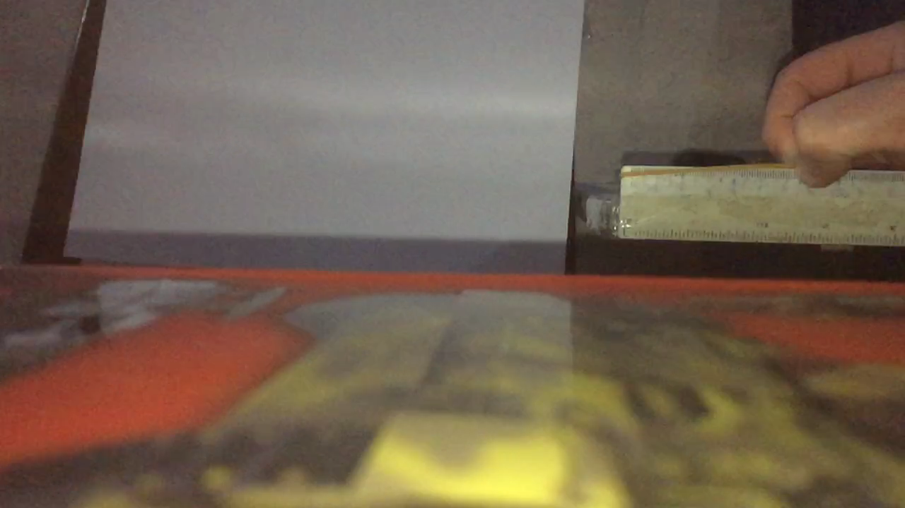
GYPT 2024
4. Shooting Rubber Band
A Rubber Band may fly a longer distance if it is non-uniformly stretched when shot, giving it spin. Optimise the distance that a rubber band with spin can reach.
Rep: Nikoloz Burduli

Slide 2
Plan
Explanation of the phenomenon
What is the cause of the rubber shot;
Why does a spinning rubber go farther;
Experimental Part
Experimental setup;
What problems did we have during the experiments and how did we fix them;
Tension of the rubber band;
Distance from the head to the point of tension;
Determination of rubber stiffness;
Different rubber bands;
Conclusion
Important parameters;

Slide 3
Explanation of the phenomenon

Slide 4
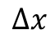
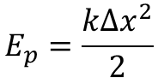
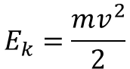
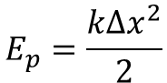
What is the cause of the rubber shot
$$E_{p}=\frac{k{∆x}^{2}}{2}$$
$$E_{k}=\frac{mv^{2}}{2}$$
$$∆x$$
$$E_{p}=\frac{k{∆x}^{2}}{2}$$
Notes:
If we take a rubber band and stretch it to a certain delta x length, we give it some initial potential energy, and as soon as the rubber band is released, this potential energy is converted into kinetic energy and the rubber band shoots out. During non-uniformly stretch, a certain part of the rubber acquires a greater speed than the other part, and therefore the rubber begins to rotate.

Slide 5
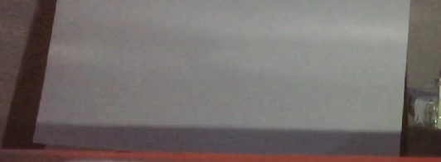
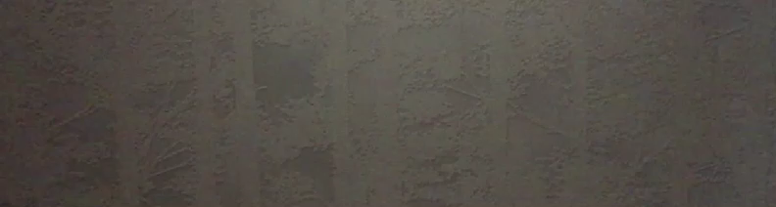
Why does the spinning rubber go farther
Uniformly
Non-Uniformly
Notes:
To understand why a spinning rubber goes farther, let's look at and compare the difference between throwing a uniformly stretched rubber and a non-uniformly stretched rubber. The video above shows a uniformly stretched rubber being thrown, and if you look at it, it is very chaotic, because of that it have a large area of contact with the air. However, when stretched non-formly, the rubber flies flat and spins with it, which is why it touches the air with less area and the air resistance is less. That's why spinning rubber flies farther.

Slide 6
Experimental Part

Slide 7
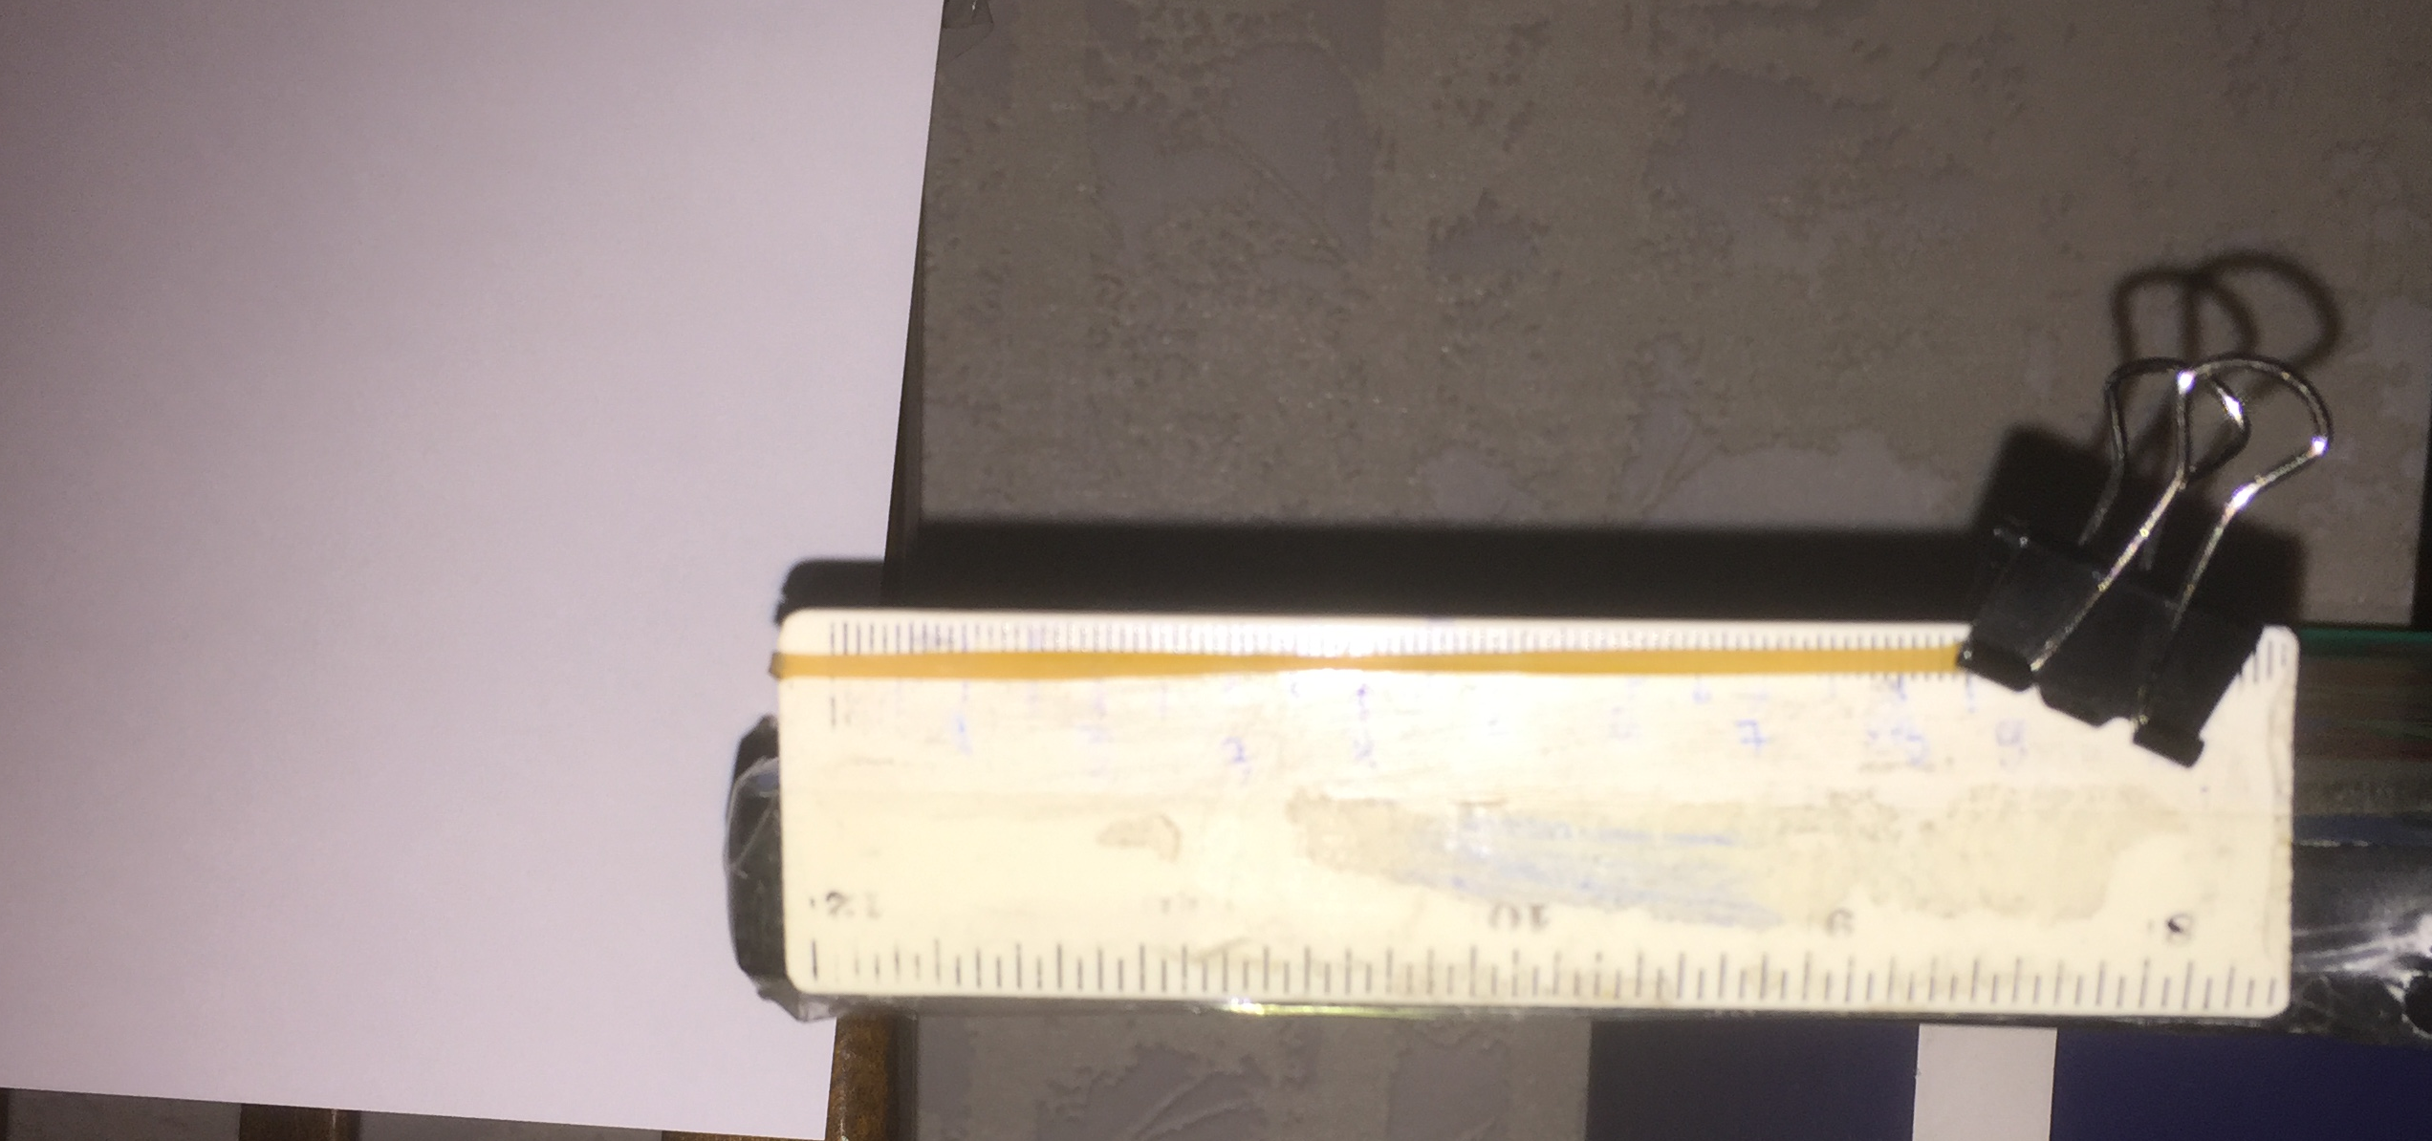
Experimental Setup 1
Rubber Band
Shooting Mechanism
Ruler
Notes:
This is my original setup, using a ruler to stretch the rubber and a trigger to shoot it.

Slide 8
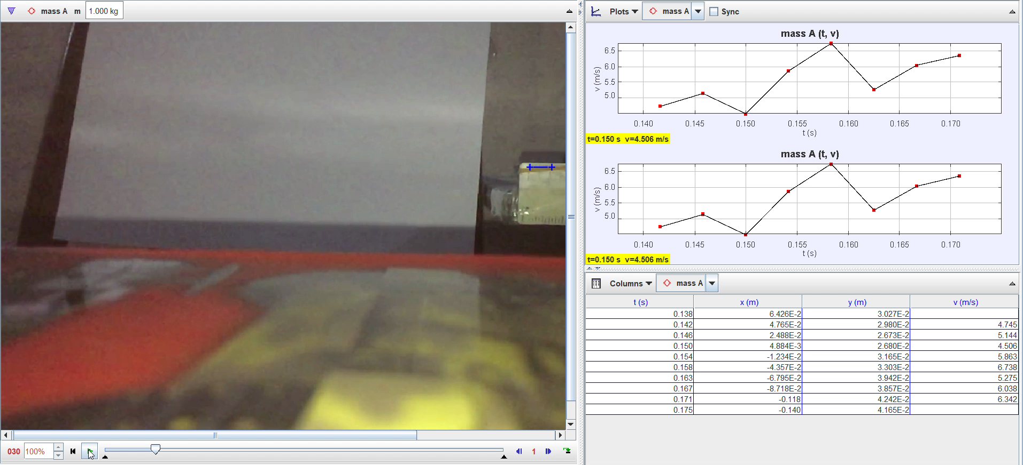
Observation of Experiments
Notes:
I used the tacker to observe the experiments, from tracker I received such data as the initial speed or the shooting rubber band.

Slide 9
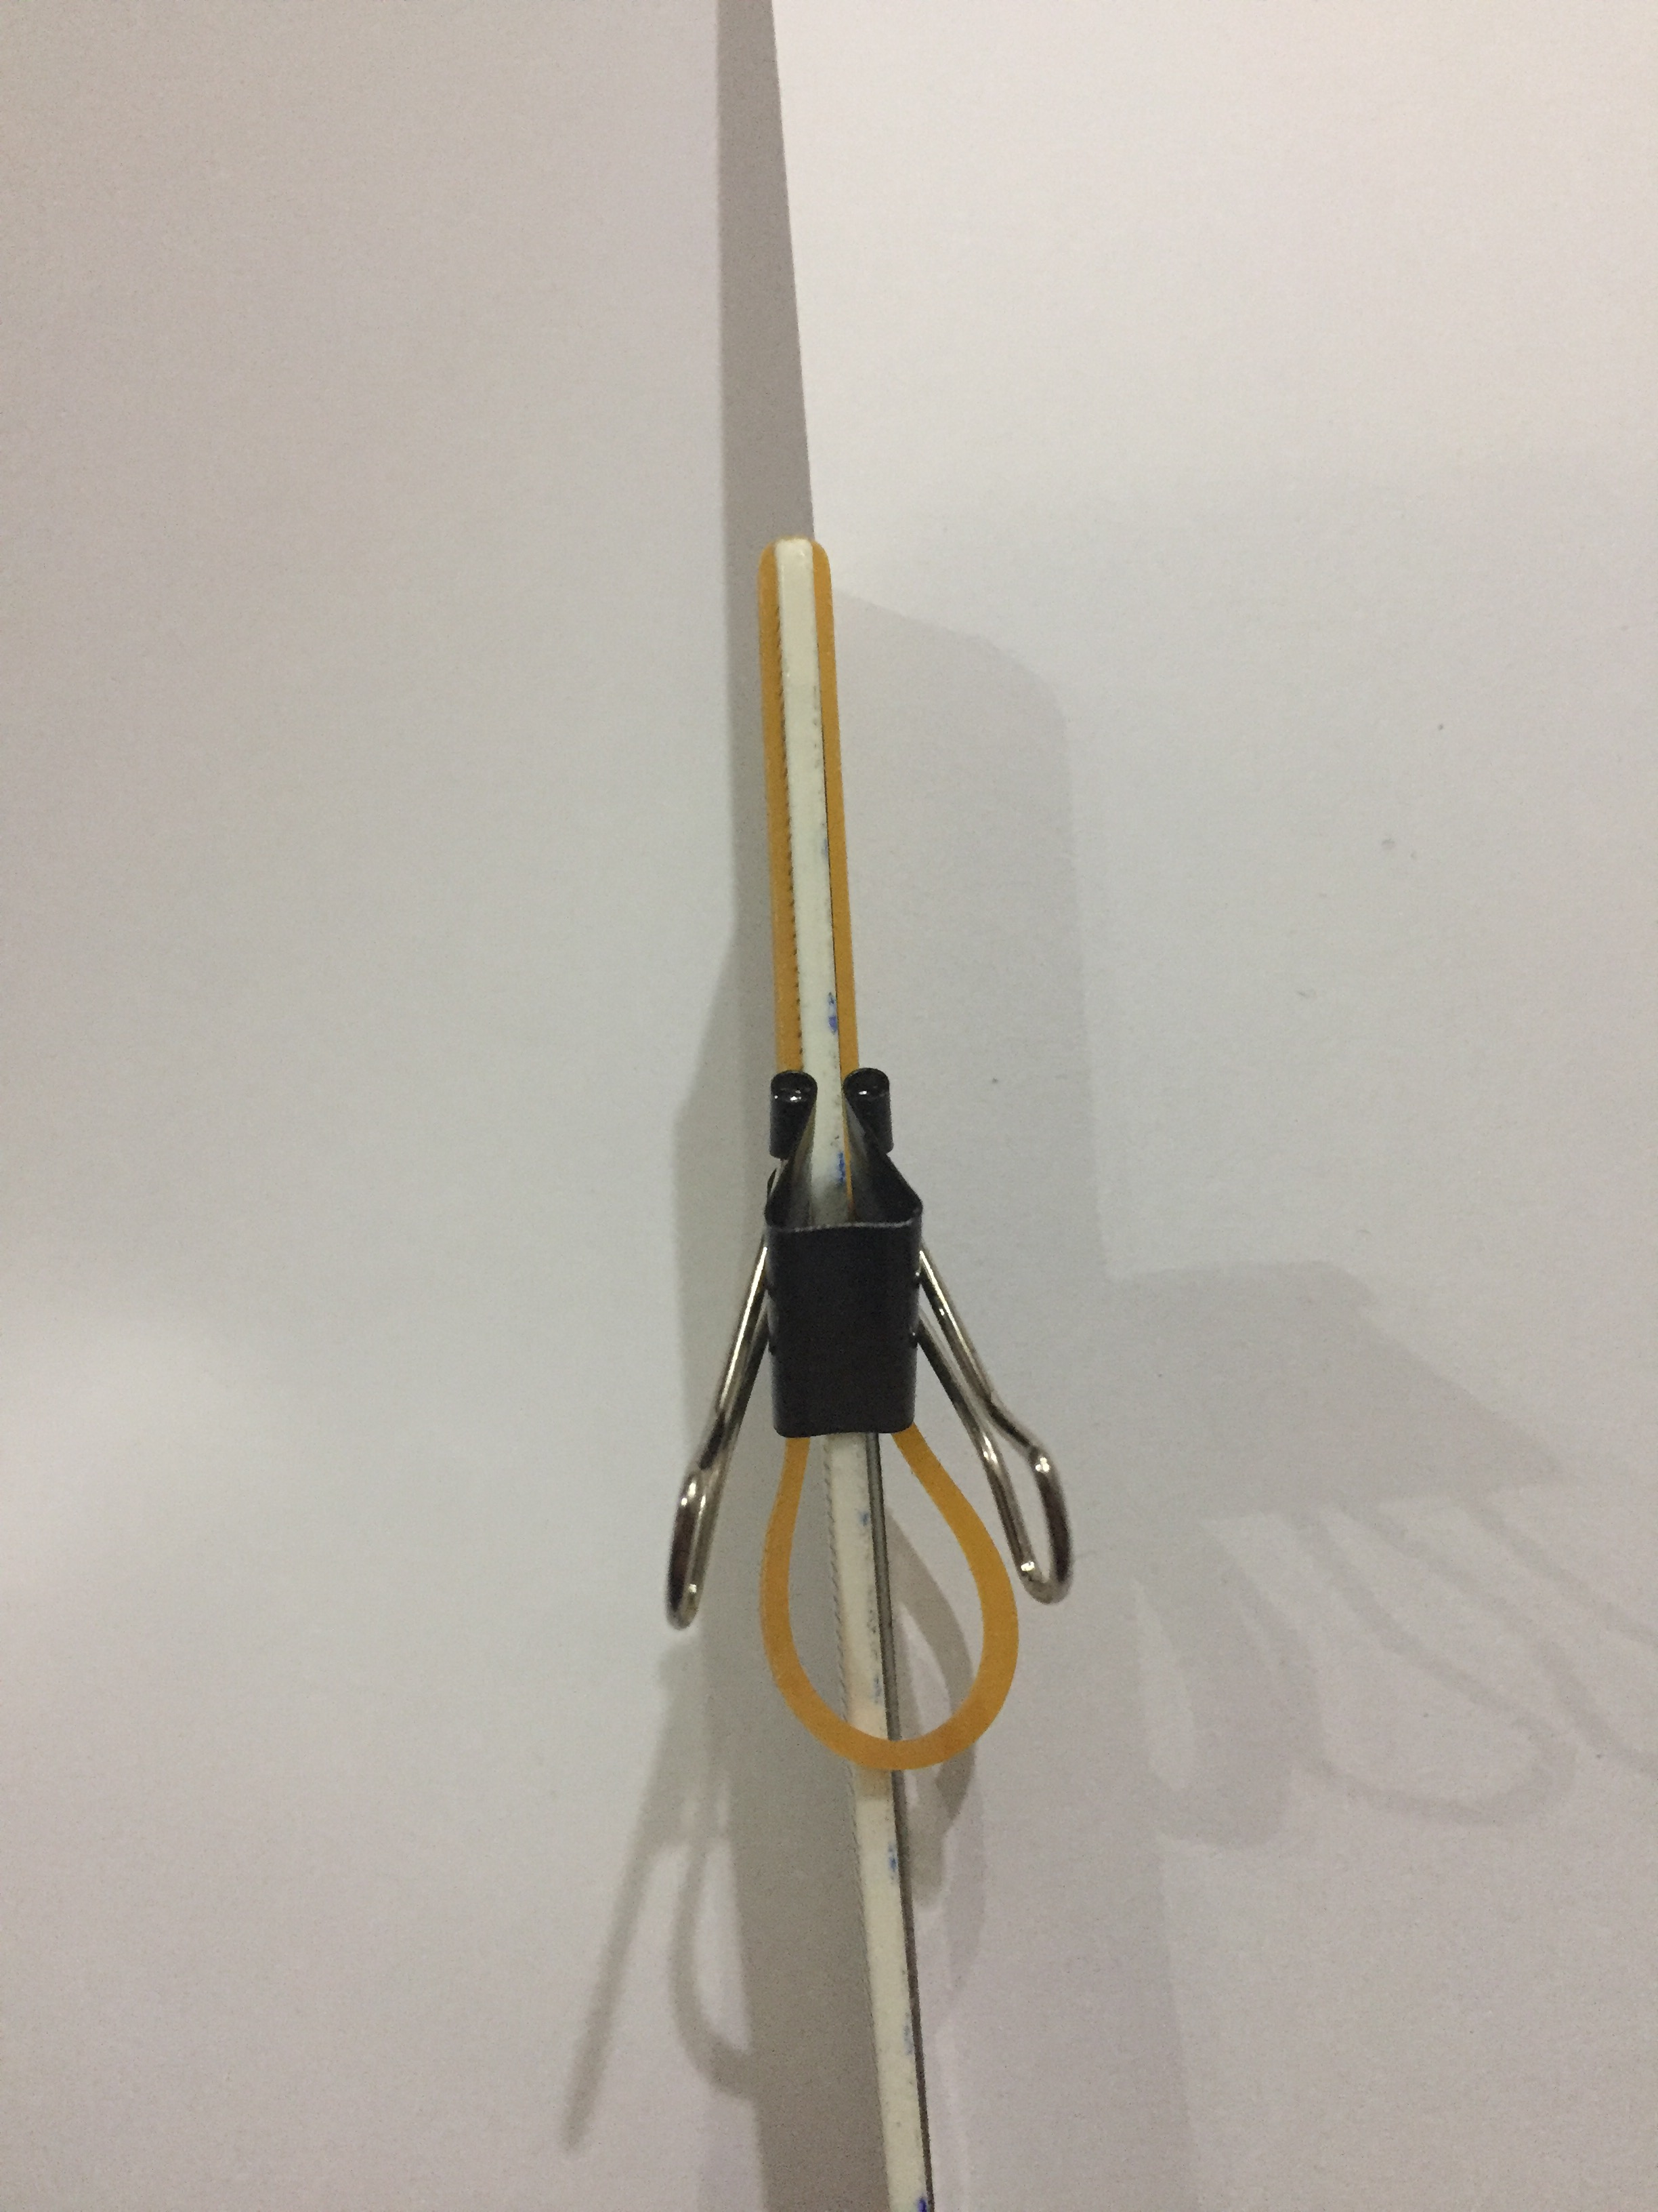
Distance from the head to the point of the stretch
Notes:
The first experiment I did was to hold the clamp at a certain distance from the head of the rubber and pull it with a different delta X. I got such a result that the longer I stretch, the faster the rubber flies, which is logical because we give the rubber more energy. Before looking at the other results, I thought that this setup would have some problem - the rubber could hit the ruler at the moment of the shot and lose energy due to some friction with the ruler.

Slide 10
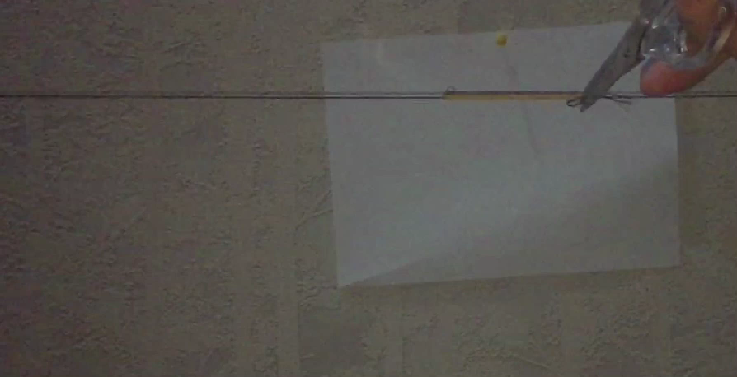
Experimental Setup 2
Notes:
Therefore, I conducted a second type of experiment where I used a thread to stretch the rubber. I made a thread on both sides of the rubber band, stretched it at different distances and cut the thread close to the head of the rubber band. In this case, nothing prevented the development of the initial speed of the rubber. Then I wanted to compare the results of both experiments, and as you can see, they are in good agreement with each other. Therefore, I considered that the first setup worked well.

Slide 11
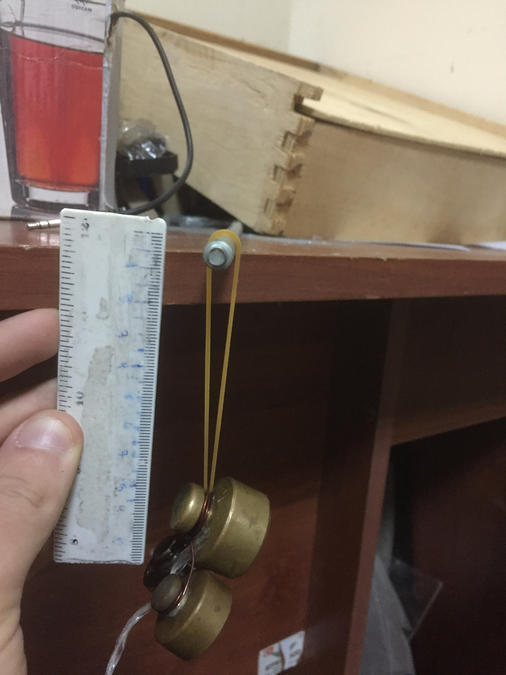
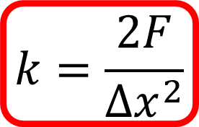
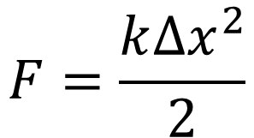
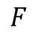
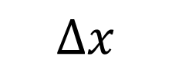
Determination of the rubber stiffness
$$F=\frac{k{∆x}^{2}}{2}$$
$$∆x$$
$$k=\frac{2F}{∆x^{2}}$$
$$F$$
Notes:
During the experiments, I also calculated the stiffness of the rubber with this simple experiment. Knowing the initial length of the rubber, I hung a load of a certain mass on it and observed the change in the length of the rubber.

Slide 12
A problem with multiple uses of rubber
Notes:
Another problem I had during the experiment was damage to the same rubber when using it multiple times. To test this, I ran the exact same experiment with the same rubber 15 times, and as you can see, the more times I used the rubber, the lower the shooting velocity. That is why I conducted each experiment with a new rubber.

Slide 13
Distance from the head to the point of the stretch
Notes:
Now let's move on to the experimental results. These graphs show the relationship of delta X to shooting initial velocity. Between these graphs I vary the distance from the head of the rubber to the grip point. And in this case, I got the same result, that the longer we stretch, the faster it goes, because we give it a bigger initial energy. As for the errors. I conducted each experiment 7-7 times and averaged the results. And the difference between the maximum and minimum result is the error.

Slide 14
Delta x - constant
Notes:
In this case, delta x is constant on each graph and we change the grip point. As you can see, the longer the distance from the head to the grip point, the faster the shot. Which is caused by the fact that the farther point we stretch, the more stiffness we have, and accordingly we have more energy.

Slide 15
Uniformly VS Non-uniformly
Uniformly
Non-Uniformly
Notes:
Now I wanted to compare the initial speeds of uniformly and non-uniformly stretched rubbers. To do this, I gave the same initial energy to both rubbers and observed the initial shooting velocity. As you can see, with their errors, their speeds almost match each other, but if we compare the experimentally measured flight distance, we will see that the non-uniformly stretched rubber flew farther. But this difference is not very big.

Slide 16
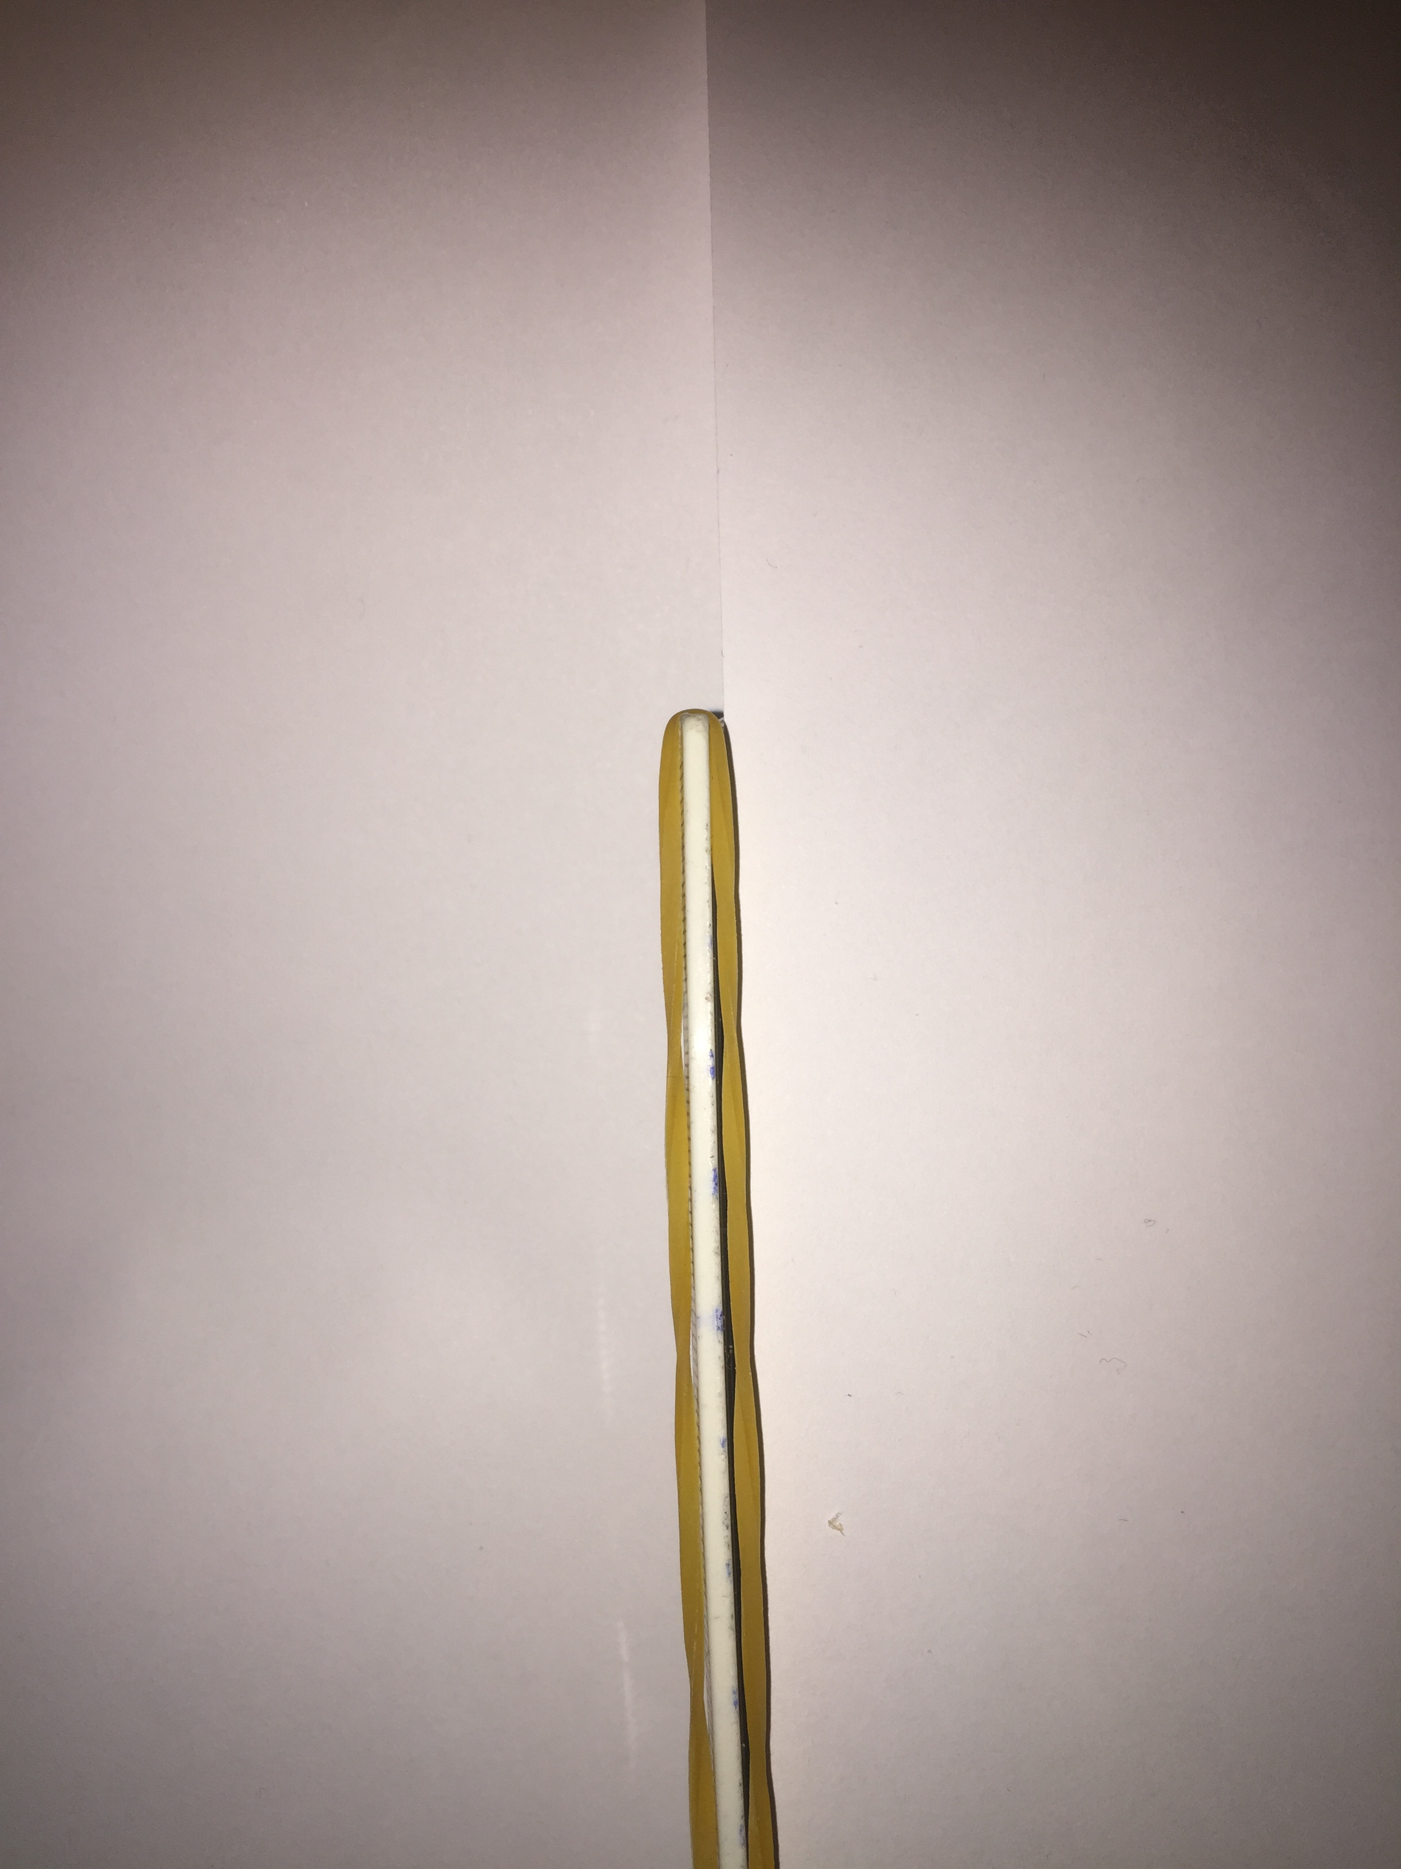
Second type of shooting
Uniformly
Non-Uniformly
Notes:
That's why I conducted a new type of experiment where I stretched only one side of the rubber and shot like that. Even in this case, the speeds of uniform and non-uniformly stretched rubbers are still equal, although the distance of flight is much greater for non-uniformly stretched rubber.

Slide 17
Conclusion

Slide 18

$$Important parameters$$
Rubber band Stiffness;
Rubber tension;
The distance from the rubber head to the grip point;
Air resistance;
Notes:
In the conclusion, I would like to summarize the important parameters in this task: they are: I showed my experiments and constructed graphs, through which we realized that non-uniform tension only changes the flight distance, not the speed, due to less air resistance.

Slide 19
1 EXP - I was stretching from both sides
2 EXP - I was stretching only on one side
Notes:
And also if we compare the two types of non-uniform tension that I used, this graph shows that the second type of tension where we only stretch the rubber from one side is more effective and flies farther.

Slide 20
Thanks for your attention!

Slide 21
გეგმა
მოვლენის ახსნა
რატომ ხდება რეზინის გასროლა;
თეორიული მოდელი
პოტენციური და კინეტიკური ენერგია;
საწყისი სიჩქარე;
ექპსერიმენტული ნაწილი
ექსპერიმენტული დანადგარი;
რეზინის დაჭიმულობა;
მანძილი სათავიდან დაჭიმვის ადგილამდე;
რეზინის სიხისტის დადგენა;
რეზინის სიხისტის ცვლილება;
თეორიული და ექსპერიმეტნული შედეგების შედარება
თეორიული და ექსპერიმენტული გრაფიკები;
დასკვნა
მნიშვნელოვანი პარამეტრები;
მონაცემთა ანალიზი;

Slide 22
თეორიული მოდელი

Slide 23
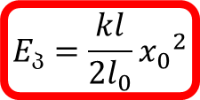
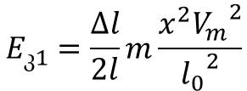
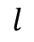
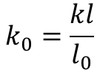
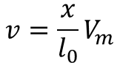
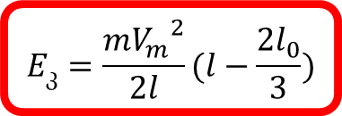
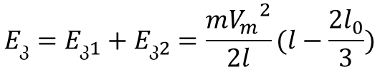
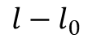
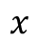
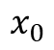
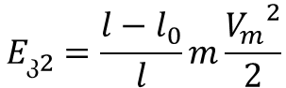
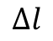
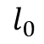
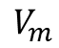
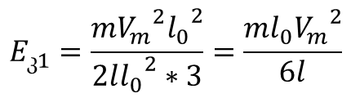
კინეტიკური და პოტენციური ენერგია
$$k_{0}=\frac{kl}{l_{0}}$$
$$l$$
$$v=\frac{x}{l_{0}}V_{m}$$
$$E_{პ}=\frac{kl}{2l_{0}}{x_{0}}^{2}$$
$$E_{კ1}=\frac{∆l}{2l}m\frac{x^{2}{V_{m}}^{2}}{{l_{0}}^{2}}$$
$$E_{კ1}=\frac{m{V_{m}}^{2}{l_{0}}^{2}}{2l{l_{0}}^{2}∗3}=\frac{ml_{0}{V_{m}}^{2}}{6l}$$
$$l_{0}$$
$$x_{0}$$
$$l−l_{0}$$
$$E_{კ2}=\frac{l−l_{0}}{l}m\frac{{V_{m}}^{2}}{2}$$
$$x$$
$$V_{m}$$
$$∆l$$
$$E_{კ}=E_{კ1}+E_{კ2}=\frac{m{V_{m}}^{2}}{2l}(l−\frac{2l_{0}}{3})$$
$$E_{კ}=\frac{m{V_{m}}^{2}}{2l}(l−\frac{2l_{0}}{3})$$

Slide 24
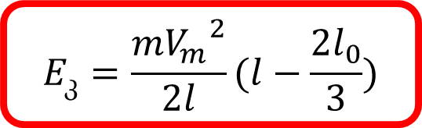
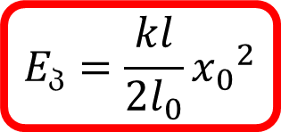
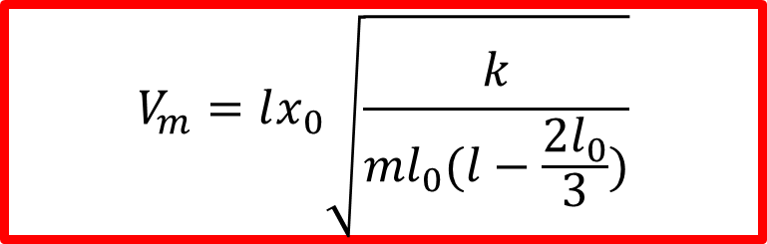
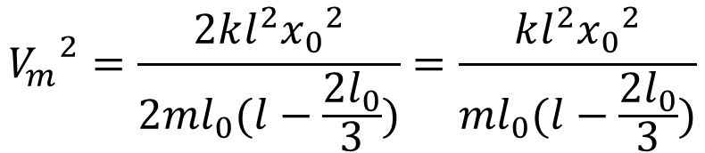
$$E_{კ}=\frac{m{V_{m}}^{2}}{2l}(l−\frac{2l_{0}}{3})$$
$$E_{პ}=\frac{kl}{2l_{0}}{x_{0}}^{2}$$
$${V_{m}}^{2}=\frac{2kl^{2}{x_{0}}^{2}}{2ml_{0}(l−\frac{2l_{0}}{3})}=\frac{kl^{2}{x_{0}}^{2}}{ml_{0}(l−\frac{2l_{0}}{3})}$$
$$V_{m}=lx_{0}\sqrt{\frac{k}{ml_{0}(l−\frac{2l_{0}}{3})}}$$

Slide 25
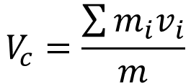
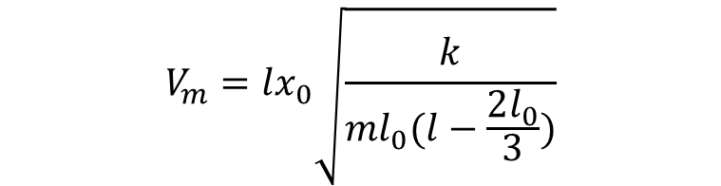
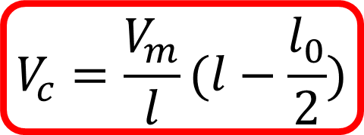
$$V_{c}=\frac{\sum{m_{i}v_{i}}}{m}$$
$$\sum{m_{i}v_{i}}=\int_{0}^{l_{0}}{\frac{∆l}{l}m∗\frac{x}{l_{0}}V_{m}+\frac{l−l_{0}}{l}{mV}_{m}=\frac{mV_{m}}{ll_{0}}}∗\frac{{l_{0}}^{2}}{2}+\frac{l−l_{0}}{l}mV_{m}=\frac{mV_{m}}{l}(l−\frac{l_{0}}{2})$$
$$V_{m}=lx_{0}\sqrt{\frac{k}{ml_{0}(l−\frac{2l_{0}}{3})}}$$
$$V_{c}=\frac{V_{m}}{l}(l−\frac{l_{0}}{2})$$

Slide 26
გასროლის სიჩქარის გამოკვლევა

Slide 27
რეზინის მრავალჯერადად გამოყენება

Slide 28
რეზინის სიხისტის ცვლილება

Slide 29
რეზინის სიგრძის ცვლილება

Slide 30


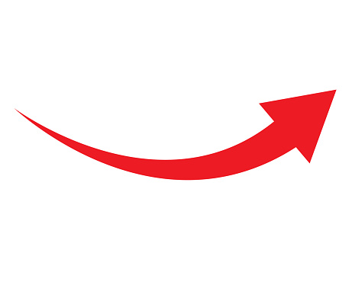
ექსპერიმენტული პროგრამები
$$Excel$$

